Slide 1




PMS Project Update
2025 Oct

Slide 2




Today's Decision
Team Structure Update
Evaluation Process(How we selected)
Final Vendor Scorecard – MRI & Kingdee(Results)
Future Roll-out plan

Slide 3
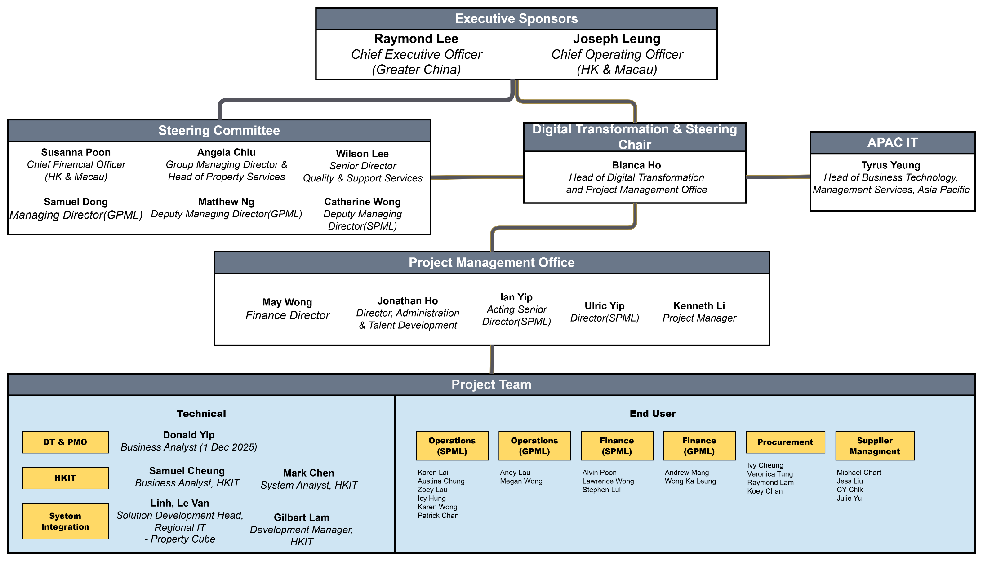
Project Governance Structure Cross-functional team ensuring successful delivery
Project team

Slide 4




Three-Stage Selection Process From 3 vendors to final recommendation through structured evaluation
RFQ & Demo Stage
Deep-dive Session Stage
Scope & Negotiation Stage
Deep-dive session week per vendor
Evaluation Scorecard by PSC & PMO
Detailed discussion on scoping & solution
Negotiation on licenses & pricing
Finalize contract terms
Issued RFQ to 3 vendors
2 hours initial demo
Demo feedback form by PSC & PMO
Evaluation process

Slide 5
Evaluation Framework Overview Balanced assessment across functional, technical, strategic, and financial criteria
Category | Sub-Category
Functional (30%) | Master Data & Profile | 7.5 | 7.8
 | Financial Management | 7.0 | 7.0
 | Procurement | 7.6 | 7.5
 | Reporting | 7.2 | 7.8
 | Core Platform Functions | 7.4 | 7.6
Non-Functional (20%) | Technical Solution & Arch. | 7.4 | 7.3
 | Vendor Profile | 7.6 | 7.8
 | Support Model & SLA | 7.2 | 6.9
Business & Strategic(20%) | Ease of Use & Operational Efficiency | 7.75 | 7.5
 | Cost-Effectiveness | 9 | 6.75
 | Regional Scalability & Unified Platform | 8.75 | 7.75
 | Strategic Alignment | 8.25 | 7.75
scorecard
*Score from 1 (Does Not Meet Requirement) to 10 (Exceeds Requirement)

Slide 6
Total Cost of Ownership Comparison Kingdee offers 55% savings over 5-year period
 |  |  |  | Variance
CAPEX | Implementation Service | $4.5M (1417man days)² | $8.0M (754man days)² | -3.5M
OPEX | First Year license fee | $1M (120 superusers + 700 site users)¹ | $5.8M (120 concurrent users) | -4.8M
OPEX | Annual license & support fee | $1M | $1.8M | -0.8M
 | Total Cost of Ownership – 5 years | $9.5M | $21M | -11.5M
pricing
Kingdee – additional super user price. e.g. +30 super user = + HKD50k / annually
Average Cost per man day: Kingdee: $3,450, MRI: $10,696

Slide 7
Vendor Evaluation Results Kingdee achieves 75.43/100 vs MRI 65.85/100
Category | Module | Kingdee | MRI | Weighting
Functional | Master Data & Profile, Financial Management, Procurement to Pay, Reporting, Core Platform Functions | 7.39 | 7.52 | 30 | 22.01*0.9 | 22.55
Non-Functional | Tech. Solution & Arch., Vendor Profile, Support Model & SLA | 7.46 | 7.4 | 20 | 14.92*0.9 | 14.85
Business & Strategic | Ease of Use & Operational Efficiency, Cost-Effectiveness, Regional Scalability & Unified Platform, Strategic Alignment | 8.44 | 7.44 | 20 | 16.88*0.9 | 14.88
Price | Total Cost of Ownership – 5 years | $9.5M | $21M | 30 | 30*0.9 | 13.57
 |  |  | Total | 100 | 75.43 | 65.85
summary
Kingdee submitted proposal 2 weeks late; 10% scoring penalty applied across all categories
Price Score = (Lowest TCO / Vendor's) * 100

Slide 8
Phased Implementation Roadmap Pilot validation followed by the mass deployment
DRAFT
Pilot-Run
SPML
3 Leaders
GPML
2 Leaders
1-2 show case sites per Leader
Total:
5-10 sites
Mass Deployment
SPML:
14 Team Heads
Total 450+sites
4 Wave by Team Heads
GPML:
16 Regions
Total 220+ sites
4 Wave by Regions
Propose two month per wave
Will adjust the duration of each wave
Workflow Design
System Design
2025 Q4
2026 Q1
Oct: Confirm Vender
Oct - Nov: Contract Negotiation
Early Nov: Approval by HK Management
Target Dec 3:
Table to GEB for approval
2026 Q2
2026 Q3
2026 Q4
2027 Q1
2027 Q2+
System Configuration
roadmap
Customization Development
Integration
Data Preparation
Data Migration
SIT
User UAT

Slide 9
Thank you

Slide 10
Appendix
Date: Sep 2025

Slide 11
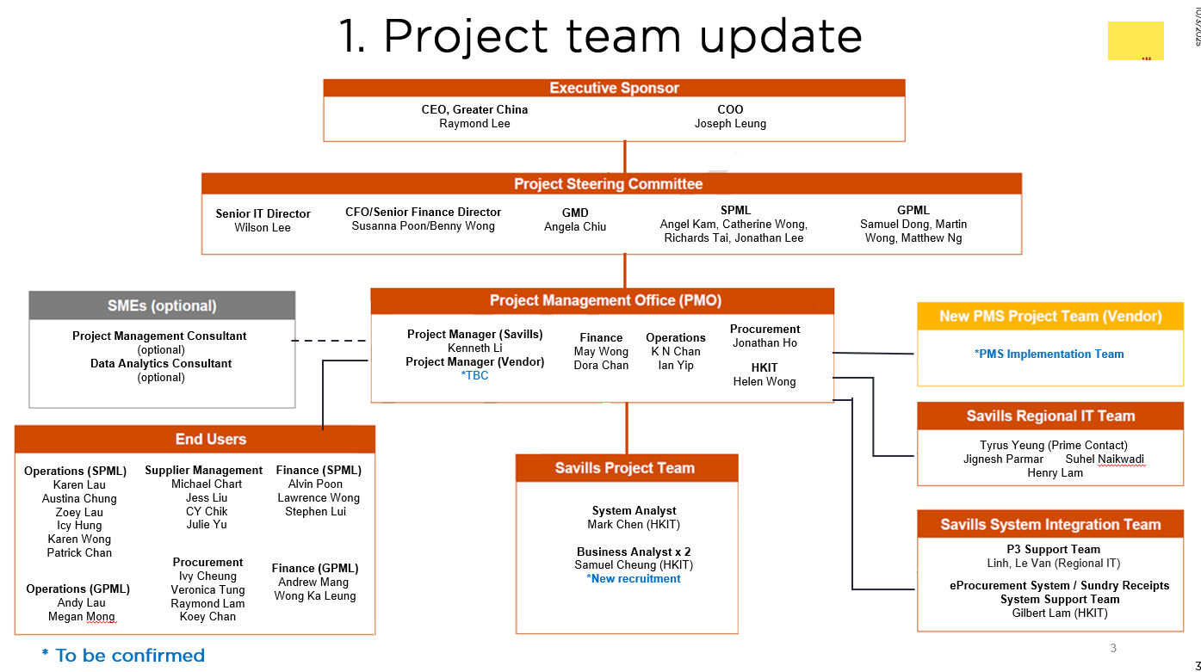
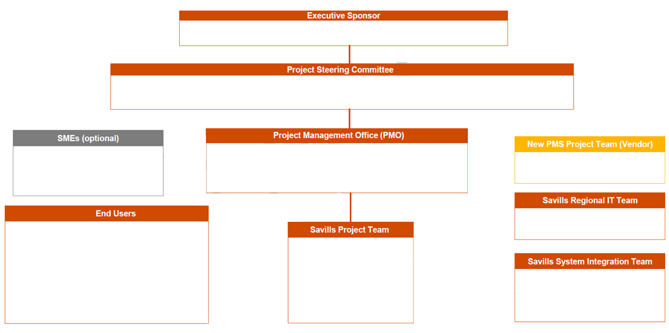
1. Project team update
CEO, Greater China
Raymond Lee
COO
Joseph Leung
Senior IT Director
Wilson Lee
CFO/Senior Finance Director
Susanna Poon/Benny Wong
GMD
Angela Chiu
SPML
Angel Kam, Catherine Wong,
Richards Tai, Jonathan Lee
GPML
Samuel Dong, Martin Wong, Matthew Ng
Project Management Consultant
(optional)
Data Analytics Consultant
(optional)
Project Manager (Savills) Kenneth Li
Project Manager (Vendor) *TBC
Finance
May Wong
Dora Chan
Operations
K N Chan
Ian Yip
Procurement
Jonathan Ho
*PMS Implementation Team
HKIT
Helen Wong
Tyrus Yeung (Prime Contact)
Jignesh Parmar Suhel Naikwadi
Henry Lam
Operations (SPML)
Karen Lau
Austina Chung
Zoey Lau
Icy Hung
Karen Wong
Patrick Chan
Supplier Management
Michael Chart
Jess Liu
CY Chik
Julie Yu
Finance (SPML)
Alvin Poon
Lawrence Wong
Stephen Lui
System Analyst
Mark Chen (HKIT)
Business Analyst x 2
Samuel Cheung (HKIT)
*New recruitment
Procurement
Ivy Cheung
Veronica Tung
Raymond Lam
Koey Chan
P3 Support Team
Linh, Le Van (Regional IT)
Finance (GPML)
Andrew Mang
Wong Ka Leung
Operations (GPML)
Andy Lau
Megan Mong
eProcurement System / Sundry Receipts System Support Team
Gilbert Lam (HKIT)
* To be confirmed
11

Slide 12
Round 1 – Feedback after initial demo
 | Kingdee | MRI | WEC
Overall Comments | Majority: Strong Fit(64%) | Majority: Potential Fit(73%) | Majority: Not a good fit (50%)
Presentation | 3.88 | 4.23 | 3.21
Module 1: Lease to Payment | 4 | 4.5 | 3.46
Module 2: Procure to Pay | 3.9 | 4.08 | 2.69
Module 3: Reporting | 3.81 | 4.08 | 3.15
Module 4: Governance & Admin | 3.7 | 4.25 | 2.92
Strong Fit This is a leading candidate with strong fit and understanding on Savills requirements. Potential Fit A viable option, but requires further clarification on some gaps and concerns. Not a good Fit This is not a suitable solution for Savills.

Slide 13
Round 2 - Vendor Evaluation Scorecard
Category | Sub-Category
Functional(30%) | Master Data & Profile, Financial Management, Procurement to Pay, Reporting, Core Platform Functions
Non-Functional(20%) | Tech. Solution & Arch., Vendor Profile, Support Model & SLA
Business & Strategic(20%) | Ease of Use & Operational Efficiency, Cost-Effectiveness, Regional Scalability & Unified Platform, Strategic Alignment
Price(30%) | Total Cost of Ownership – 5 years

Slide 14
Round 2 – Functional & Non-Functional
Category | Module
Functional (50%) | Master Data & Profile | 7.5 | 7.8
 | Financial Management | 7.0 | 7.0
 | Procurement to Pay | 7.6 | 7.5
 | Reporting | 7.2 | 7.8
 | Core Platform Functions | 7.4 | 7.6
Non-Functional (20%) | Tech. Solution & Arch. | 7.4 | 7.3
 | Vendor Profile | 7.6 | 7.8
 | Support Model & SLA | 7.2 | 6.9
*Total Number of question: 19
*Score from 1 (Does Not Meet Requirement) to 10 (Exceeds Requirement)
Total Number of evaluators(PSC + PMO + Regional IT): 17
By Department
Central Mgt: 1
Finance: 4
HKIT: 1
Regional IT: 1 Admin & Training: 1
Operation SPML: 5
Operation GPML: 4

Slide 15
Round 2 - Business & Strategic Value
Sub-Category | Description | Kingdee | MRI
Ease of Use & Operational Efficiency | Assesses whether the system offers an intuitive interface, mobile accessibility, and a streamlined onboarding process for all user groups—driving higher adoption, improving workflow efficiency, and enabling remote work, seamless scaling, and business continuity with minimal disruption. | 7.75 | 7.5
Cost-Effectiveness | Assess not just upfront costs, but also long-term return on investment—consider how the software can help minimize vacancies, cut operational costs, and boost revenue over time | 9 | 6.75
Regional Scalability & Unified Platform | Assesses the PMS’s ability to support Savills’ business growth, cross-border operations, and a consolidated view of property portfolios in Hong Kong, China, and APAC. | 8.75 | 7.75
Strategic Alignment | Maps the vendor vision to Savills' digital transformation roadmap by standardizing workflows, enabling data-driven decision making | 8.25 | 7.75
*Score:
10 – Fully aligned: Perfectly matches and enables Savills’ long-term priorities and business strategy with clear, documented benefits.
5 – Moderately aligned: Meets minimum criteria with mixed relevance to Savills’ future needs and only partial strategic fit.
1 – Not aligned: Does not reflect Savills’ business direction or strategic objectives; major shortcomings.
Total Number of evaluators(PSC): 6
By Department
Central Mgt: 1
Finance: 1
HKIT: 1
Operation SPML: 1
Operation GPML: 2

Slide 16
Kingdee vs MRI
Category | Sub-Category | Kingdee | MRI | Comment
Strategic & Business | Regional Strategy | ✓ |  | Kingdee's proven success in Savills China offers strong regional synergies and standardization, while MRI's fragmented solution lacks synergies with JP & ANZ deployments.
 | Innovation & Commercial Value | ✓ |  | Kingdee delivers a more holistic ERP solution with a strong roadmap and proven cost savings in the region, whereas MRI presents high investment with performance risks and uncertain returns .
Functional | Module integration (PM & Procurement) | ✓ |  | Kingdee offers integrated modules on the same platform with seamless data flow, while MRI uses two separate products (Simplicity recently acquired) .
 | Payment Collection | ✓ |  | Kingdee supports local payment methods (Alipay, WeChat, FPS) natively, while MRI requires a payment gateway that incurs higher transaction costs .
 | Reporting | - | - | Both require customization: Kingdee uses China version reports, MRI uses UK version. Both need tailoring for bilingual, site-specific reporting .
 | AI component | - | - | Both vendors’ AI capabilities are still at an early stage and not yet mature in their current solutions. However, both have clear AI development roadmaps and potential to enhance automation and analytics in future releases.
Non-Functional | On-site implementation | ✓ |  | Kingdee includes on-site support in Savills Office as standard, while MRI charges it as an add-on service .
 | Post go-live support | ✓ |  | Kingdee's Shenzhen team offers native Cantonese/Mandarin support, enabling faster escalation and issue resolution. MRI's distributed APAC team operates in English with longer escalation chains across multiple regions.

Slide 17
Round 2 - Vendor Evaluation Scorecard
Category | Sub-Category
Functional(30%) | Master Data & Profile, Financial Management, Procurement to Pay, Reporting, Core Platform Functions
Non-Functional(20%) | Tech. Solution & Arch., Vendor Profile, Support Model & SLA
Business & Strategic(20%) | Ease of Use & Operational Efficiency, Cost-Effectiveness, Regional Scalability & Unified Platform, Strategic Alignment
Price(30%) | Total Cost of Ownership – 5 years

Slide 18
Round 2 - Vendor Evaluation Scorecard(Weighted)
Category | Module |  | Kingdee | MRI | Weighted | Kingdee | MRI
Functional(30%) | Master Data & Profile | Property & Client Master | 7.71 | 7.82 | 2.5 | 1.91 | 1.97
 |  | Lease & Contract Management | 7.35 | 7.71 | 2 | 1.46 | 1.54
 | Financial Management | Billing & Invoicing | 7.29 | 7.41 | 2.5 | 1.81 | 1.84
 |  | Collection & Credit Control | 7.24 | 7.47 | 2 | 1.44 | 1.49
 |  | Sundry Receipts & Deposits | 6.71 | 6.35 | 2 | 1.33 | 1.25
 |  | Vendor Management | 7.65 | 7.35 | 2 | 1.53 | 1.48
 | Procurement to Pay | Procurement & PO Processing | 7.59 | 7.59 | 2.5 | 1.89 | 1.89
 |  | Invoice Matching & Payment | 7.59 | 7.41 | 2 | 1.51 | 1.49
 | Reporting | Standard & Financial Reporting | 7.24 | 7.71 | 2.5 | 1.80 | 1.94
 |  | BI & Analytics | 7.29 | 7.88 | 2.5 | 1.81 | 1.97
 | Core Platform Functions | Approval Workflow | 7.53 | 7.76 | 1 | 0.75 | 0.78
 |  | System log and audit trail | 7.41 | 7.53 | 2 | 1.48 | 1.51
 |  | User/Role management | 7.47 | 7.59 | 2 | 1.48 | 1.51
 |  | Security setting | 7.35 | 7.65 | 2.5 | 1.83 | 1.91
 |  |  |  | Total | 30 | 22.01 | 22.55
Non-Functional(20%) | Tech. Solution & Arch. | Solution Architecture | 7.53 | 7.41 | 4 | 3.01 | 2.96
 |  | Integration and Data Migration | 7.41 | 7.24 | 4 | 2.96 | 2.89
 | Vendor Profile | Market Experience | 7.29 | 7.53 | 4 | 2.92 | 3.01
 |  | Vendor Background | 7.82 | 8.00 | 4 | 3.13 | 3.20
 | Support Model & SLA | Support Model & SLA | 7.24 | 6.94 | 4 | 2.89 | 2.78
 |  |  |  | Total | 20 | 14.92 | 14.85
Business & Strategic Value(20%) | Strategic Value | Ease of Use & Operational Efficiency | 7.75 | 7.5 | 5 | 3.88 | 3.75
 |  | Cost-Effectiveness | 9 | 6.75 | 5 | 4.50 | 3.38
 |  | Regional Scalability & Unified Platform | 8.75 | 7.75 | 5 | 4.38 | 3.88
 |  | Strategic Alignment | 8.25 | 7.75 | 5 | 4.13 | 3.88
 |  |  |  | Total | 20 | 16.88 | 14.88
Price(30%) | Total Cost of Ownership | (Lowest TCO / Vendor's TCO) * 100 | 10 | 4.4 | 30 | 30 | 13.57
 |  |  |  | Grand Total | 100 | 83.81 | 65.85

Slide 19
1. project scope
Master data Management
Finance Management
Other functions
Property Profile
Landlord/Tenants/Occupant Profile
Vendor Profile
Chart of Account
Cost Center
Billing & Invoice
Sundry Receipt Management*
Debit/Credit Note
Payment collection
Fixed Asset Management
Budgeting
Lease Management
Vendor on-boarding & performance evaluation*
Procurement Management*
Inventory Management*
System integration (P3, D365, Payment Channel)
Other general functions: | User/Role management Reporting and dashboarding Approval workflow | AD authentication Security setting System log and audit trail
* New functions added after PwC review

Slide 20
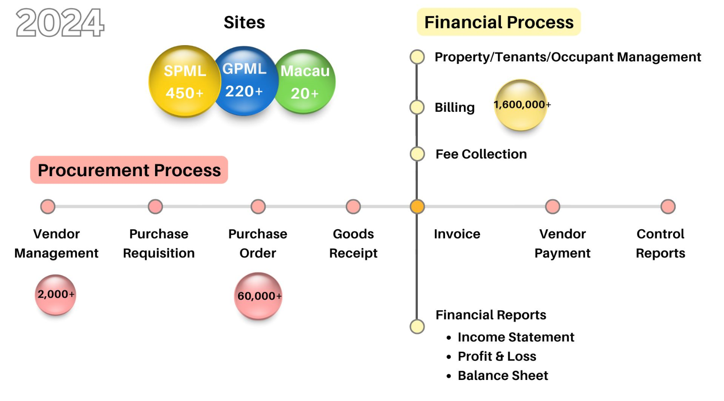

Slide 21
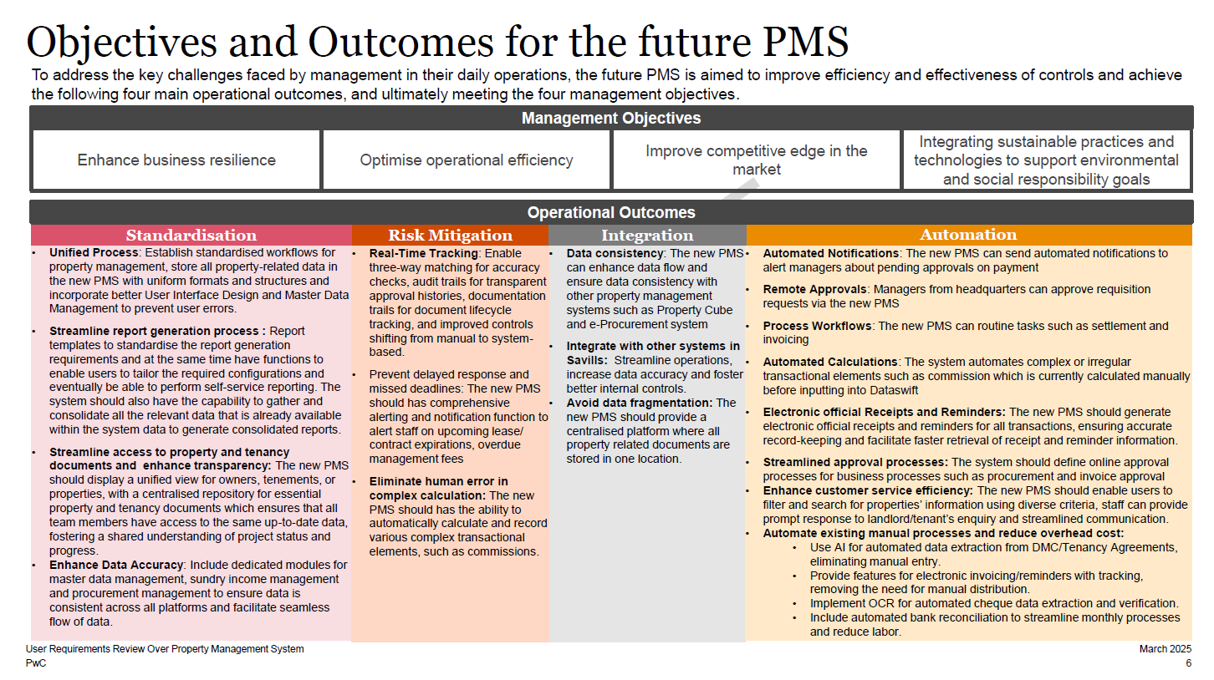

Slide 22
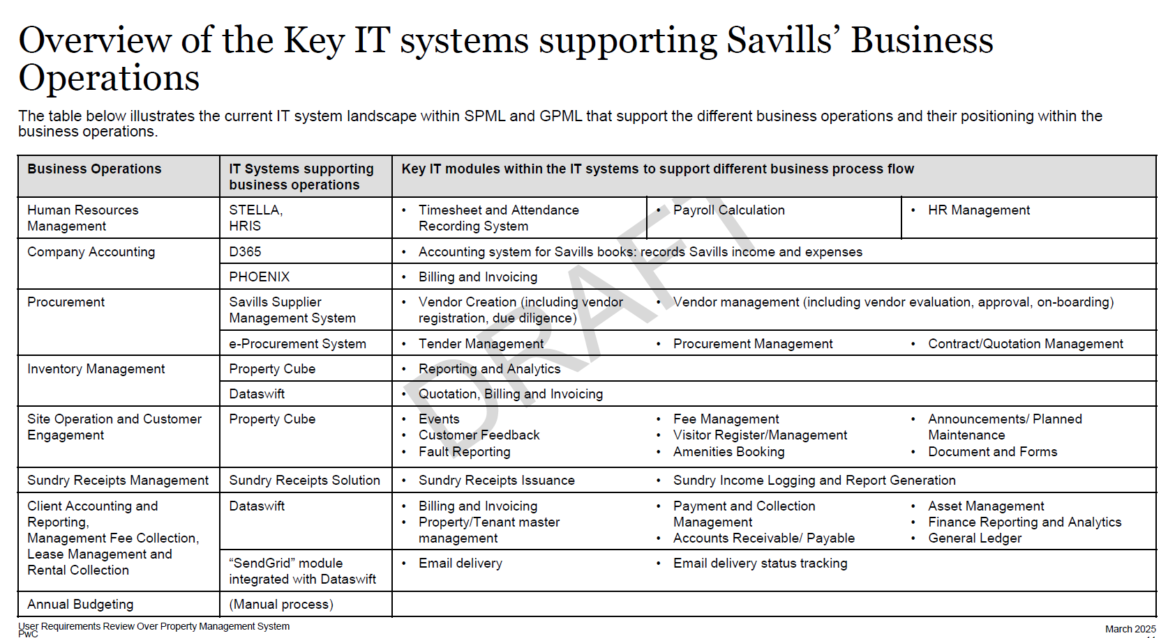

Slide 23
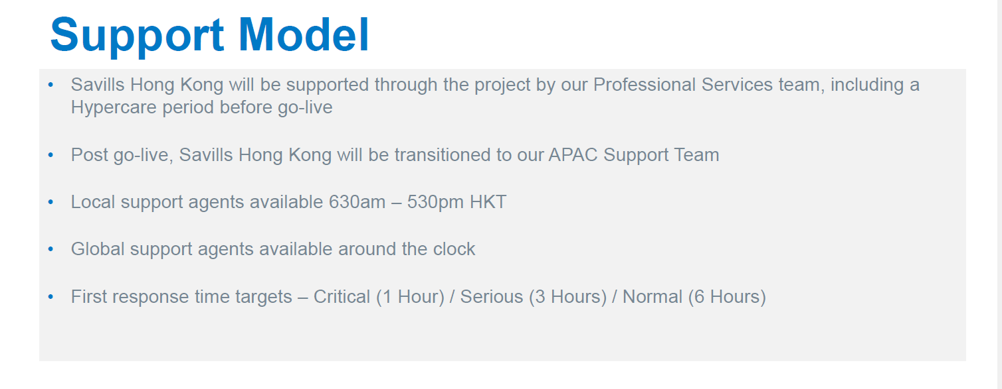
MRI Support Model

Slide 24
Project Governance Structure Cross-functional team ensuring successful delivery
Executive Sponsors
Raymond Lee Chief Executive Officer
(Greater China)
Joseph Leung Chief Operating Officer
(HK & Macau)
Steering Committee
Digital Transformation & Steering Chair
APAC
(HK Susanna Poon Chief Financial Officer
& Macau)
Angela Chiu Group Managing Director & Head of Property Services
Wilson Lee Senior Director
Quality & Support Services
Bianca Ho
Head of Digital Transformation
and Project Management Office
Tyrus Yeung Head of Business Technology,
Management Services, Asia Pacific
DMD – GPML
Samuel Dong,
Matthew Ng
DMD – SPML
Catherine Wong
Project Management Office
May Wong
Finance Director
Ian Yip Acting Senior Director(SPML)
Ulric Yip Director(SPML)
Jonathan Ho Director, Administration & Talent Development
Kenneth Li
Project Manager
Project Team
Technical
End User
DT & PMO
Donald Yip
Business Analyst (1 Dec 2025)
Operations (SPML)
Operations (GPML)
Finance (SPML)
Finance (GPML)
Procurement
Supplier Managemet
Samuel Cheung
Business Analyst, HKIT)
Mark Chen
System Analyst, HKIT
Karen Lai
Austina Chung
Zoey Lau
Icy Hung
Karen Wong
Patrick Chan
Andy Lau
Megan Mong
Alvin Poon
Lawrence Wong
Stephen Lui
Andrew Mang
Wong Ka Leung
Ivy Cheung
Veronica Tung
Raymond Lam
Koey Chan
Michael Chart
Jess Liu
CY Chik
Julie Yu
HKIT
System Integration
Linh, Le Van
Solution Development Head, Regional IT - Property Cube
Gilbert Lam
Development Manager, HKIT

Slide 25

Why we need a new PMS?
Dataswift defined as “End of Life”
Inefficient Workflows and Manual Processes
Lack of Integration and Data Silos
Limited Insight and Business Intelligence

Slide 26
Current System Diagram AS-IS
Human Resource Management
Company Accounting
STELLA
HRIS
D365
Phoenix
Procurement Management &
Vendor Management
Client Accounting and Reporting
Site Operation and Customer Engagement
eProcurement System (SPS)
Dataswift (V2)
Property Cube (P3)
Savills Supplier Management System (SSMS)
SendGrid
Sundry Receipt Management
System integration flow
Sundry Receipts Solutions
Manual data entry
Data sync through SharePoint/API
Notes:
Change the line color

Slide 27
What will be included? PMS Scope
Human Resources Management
Company Accounting
STELLA
HRIS
D365
Phoenix
New Property Management System (PMS)
Site Operation and Customer Engagement
Procurement & Vendor Management
Finance Management (including Sundry)
Property Cube (P3)
Lease Management
Master Data Management
Inventory Management
Existing integration flow
Future integration flow

Slide 28


What are we going to achieve?
Operational Outcomes
1
2
Standardisation
Risk Mitigation
3
4
Automation
Integration

Slide 29







Management Objectives
Enhance business resilience
Optimize operational efficiency
Improve competitive edge in the market
Integrating technologies to support ESG
Kingdee
TCO 5 year: 9.3M
OPEX per year: 1M
First Year OPEX + CAPEX: 5.5M
Solution Design
Configuration
Development
MRI
TCO 5 year: 21M
OPEX per year: 1.8M
First Year OPEX + CAPEX: 13.8M
2023
2024-2025 Q1 – Q2
2025 Q3
2025 Q4
Sep 30: Confirm Vender
Oct: Contract Negotiation
Early Nov: Approval by HK Management
Target Dec 3:
Table to GEB for approval
2026…
2025 Q3 – Q4
June: RFQ to three vendors
July: Received all 3 vendors proposal
July 21: 1st Demo by WEC & MRI
Aug 1: 1st Demo by Kingdee
Aug: MRI on hold due to low score in the demo feedback & no response on the supplier questionnaire
Aug: Deep Dive Sessions with MRI & Kingdee
Sep 19: Vendor Scorecard by PMO & PSC
Review on process and pain points
Detail requirements check list
Workflow diagram
Vendor evaluation process
Customization
Integration
Data Preparation & Migration
SIT & UAT

Slide 30
Executive Sponsor
CEO, Greater China
Raymond Lee
COO
Joseph Leung
Steering Committee
Project Governance
Finance
Central Management
SPML
GPML
Macau?
Bianca Ho
Susanna Poon
Angela Chiu
Angel Kam
Catherine Wong
Samuel Dong
Martin Wong
Franco Liu
Benny Wong
Wilson Lee
Richards Tai
Jonathan Lee
Matthew Ng
Project Management Office
Regional IT
Finance
Procurement
Operation
Project Management
*Dora Chan
*Jonathan Ho
*Ian Yip?
K N Chan?
Kenneth Li
Tyrus Yeung
May Wong
Macau?
TBC, Kingdee/ MRI
Project Team
Solution Design & Integration
Procurement
Finance(SPML)
Finance(GPML)
Operation(SPML)
Operation(GPML)
Michael Chart, Jess Liu, CY Chik, Julie Yu, Ivy Cheung, Veronica Tung, Raymond Lam, Koey Chan
Alvin Poon, Lawrence Wong, Stephen Lui
Andrew Mang, Wong Ka Leung
Karen Lau, Austina Chung, Zoey Lau, Icy Hung, Karen Wong, Patrick Chan
Andy Lau, Megan Mong
Samuel Cheung, Mark Chen, Gilbert Lam, New BA Hiring

Slide 31
Business & Strategic Value
Sub-Category | Description
Strategic Alignment | Maps the vendor vision to Savills’ digital transformation roadmap by standardizing workflows, enabling data-driven decision-making and so on
Regional Scalability & Unified Platform | assesses the PMS’s ability to support Savills’ business growth, cross-border operations, and a consolidated view of property portfolios in Hong Kong, China, and APAC.
Vendor Viability (Long term partnership) | Reviews financial health (revenue growth, profitability, liquidity), market capitalization, listing transparency, funding capacity, and R&D investment trajectory ​.
Risk & Resilience | Assesses on vendor implementation maturity—team expertise, change management track record, project governance, escalation processes, and continuous improvement planning
Innovation & Future-Proofing | Evaluates support for advanced analytics, AI-driven workflows, mobile access, OCR to accommodate emerging technologies ​.

Slide 32
Pre-leasing & leasing module
Feature | Module | Kingdee Supported | Mytepro Supported | Requirement Checklist not included in
Property listing control | Pre-leasing | No, no mobile app, using wechat app | Yes | No
Marketing promotion | Pre-leasing | No, no mobile app | Yes | No
Online property viewing | Pre-leasing | No, no mobile app | Yes | No
Online chat or chatbot | Pre-leasing | No, no mobile app | Yes | No
Appointment scheduling | Pre-leasing | No, no mobile app | Yes | No
Contract generation | Pre-leasing | Yes, but cant change, need to re-upload | Yes | Yes
Contract versioning | Pre-leasing | No | Yes | No
Online signing | Pre-leasing | No | Yes | No
Contract approval | Pre-leasing | Yes | Yes | No
Invoice issuance | Leasing | Yes | Yes | Yes
Bill inquiry & reminders | Leasing | Yes | Yes | Yes
Online payment & invoice download | Leasing | Yes | Yes | Yes
Payment & reconciliation | Leasing | Yes | Yes | Yes
Compliance management | Leasing | Yes | Yes | Yes
Fully self-service(renew contract, withdrawal) | Leasing | Yes | Yes | No
Payment | Leasing
Approval flow | Leasing

